Slide 1
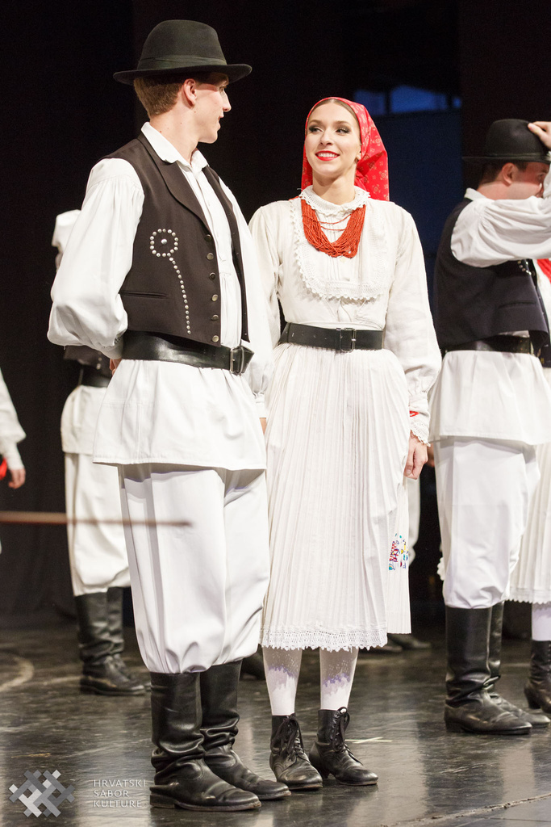
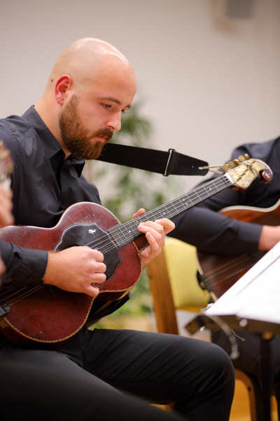

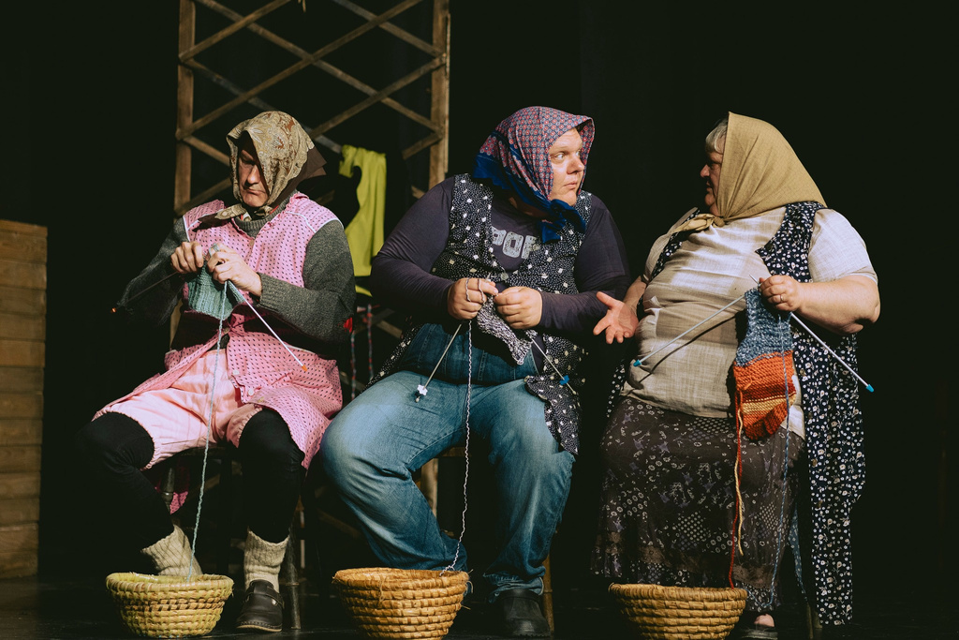
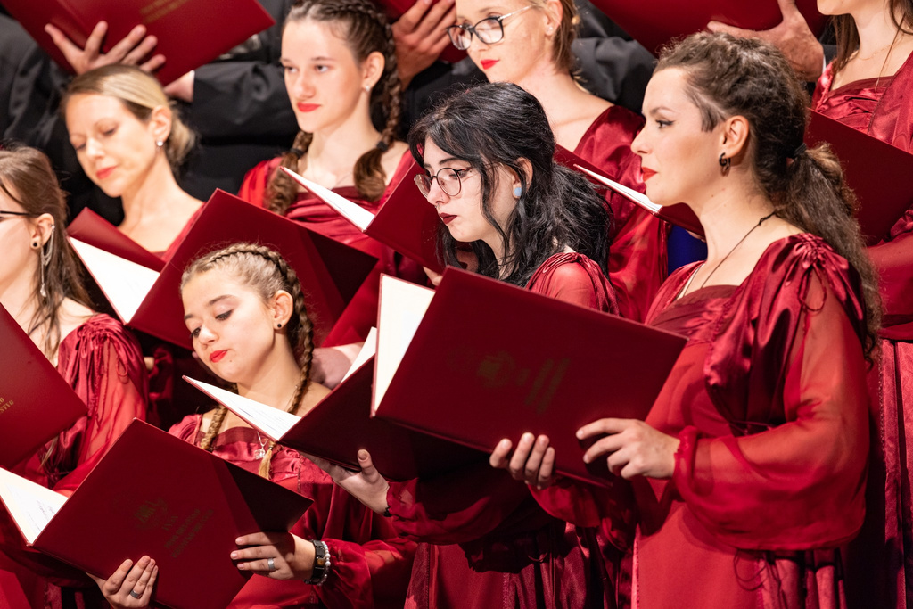
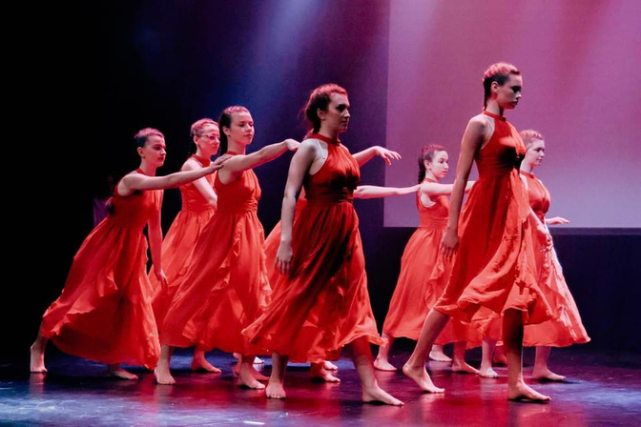
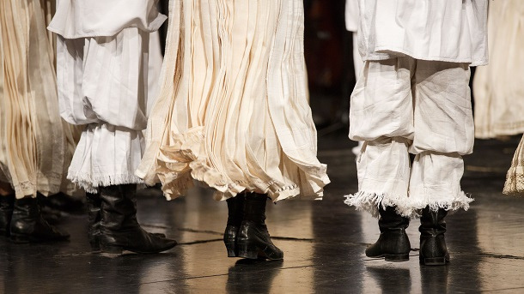

The role of Croatian Cultural Association in supporting comunities
Prague, 11. 6. 2025.

Slide 2
Hrvatski sabor kulture
was founded in 1948
Today's Croatian Cultural Association is an association and umbrella organization of amateur cultural and artistic activities in the Republic of Croatia.
Overall, the Croatian Culture Council has gathered 1,060 associations with 2,413 performing groups and more than 80,000 members.
It is financed by the Ministry of Culture and Media of the Republic of Croatia, local and regional self-
government units, other legal entities and from the membership fees.

Slide 3
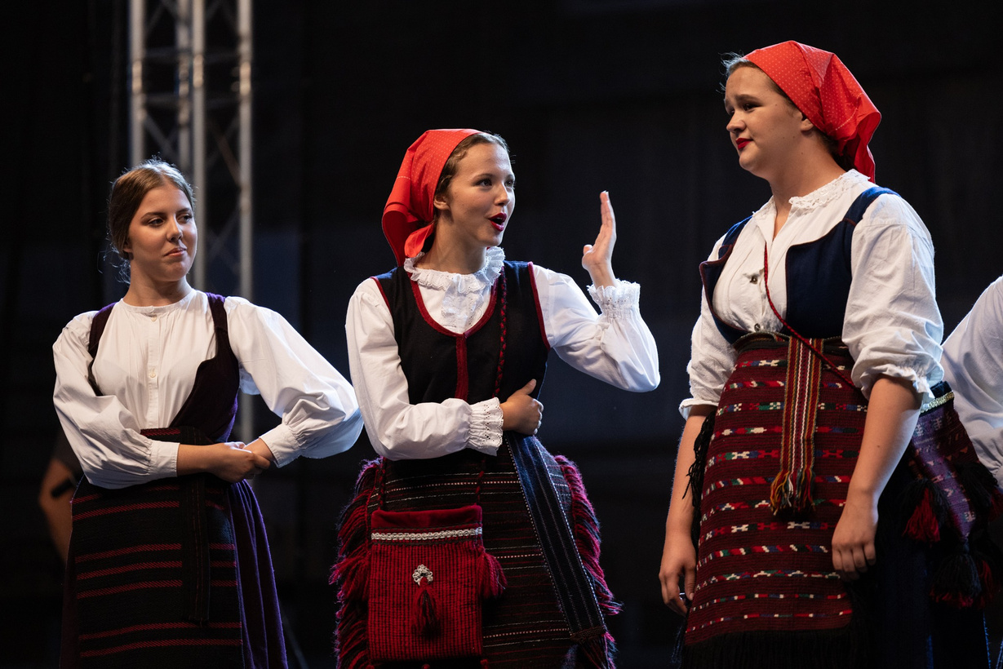
What do we do?
  professional development through seminars
  public call for vocal and instrumental pieces for choirs and orchestras
  developing publishing activities – Music and Theatre library, 2 folklore editions on dances and costumes
  providing professional and organizational assistance – 5 employees, councils for each amateur branche
  organizing events of national importance – festivals
  working on further building a comprehensive structure of Croatian cultural and artistic amateurism

Slide 4
How do we do it?
• Seminars and events of national importance
• a bridge between associations and the profession - cultural policy
• formal and informal discussions with associates, experts, members and representatives of communities
• cooperation with other partners and sectors – international cooperation – Amateo i Europa Cantat
• lobbying
• joint efforts to ensure conditions for the work and activities of associations in culture

Slide 5
HSK i.....
communities
  Enrichment of the Theatre Library and arrangement of the Music Library
  Digitalization of the HSK archive titles
  Continuous professional, organizational, IT and office assistance
  Info office of HSK members - video library
  Law on amateur cultural and artistic activities - establishment and revitalization of county communities
  Communication with HSK member associations

Slide 6
anything else......
Mreža hrvatske kulture - https://mreza.hr/naslovnica
Razglednica - https://shorturl.at/VEj8N
Choral Ties - https://www.hrsk.hr/stranica2/seminari-radionice/6/10/13
Hrvati u Sloveniji
We care – i mi isto

Slide 7

......
Thank you!
Valentina Dačnik, prof.
valentina.dacnik@gmail.com
https://www.hrsk.hr/stranica2/english/2/28/0

